Slide 1
DSC3108: Big Data Mining and Analytics
Lecture 07 (BSCS_BSDS_3:1)
Topic: Other Data Mining Techniques-Clustering Algorithms
Dr. Daphne Nyachaki Bitalo
Department of Computing & Technology
Faculty of Engineering, Design & Technology

Slide 2

COURSE OVERVIEW
Big Data
Fundamentals and Mining
Data Analytics
Architectures, storage of data
Data Mining Techniques
Descriptive analytics
Predictive analytics
Notes:
Limited empirical investigation into the challenges encountered by Master's degree students
during the dissertation writing process contributes to difficulties in completing dissertations, resulting in elevated dropout rates and delayed program completion. This study seeks to fill this research gap by examining the specific challenges and solutions.

Slide 3
Lecture Objectives and Learning outcomes
The Objectives of this lecture are :
Understand clustering data mining techniques that can be used for predictive analyses
Explore the different algorithms e.g. K-means clustering, Hierarchical clustering
By the end of this lecture, students should be able to:
Get practical experience working with clustering mining algorithms and unsupervised machine learning.

Slide 4
Lecture Overview
Unsupervised Machine Learning
Clustering mining algorithms
K-means clustering
Hierarchical clustering
Hands-on practical

Slide 5
Data Mining Techniques
Data mining process: CRISP-DM methodology
Data exploration and visualization
Association rule mining
Classification algorithms (Decision trees, Naïve Bayes, Support Vector Machines)
Clustering algorithms (K-means, hierarchical clustering)
Outlier detection

Slide 6
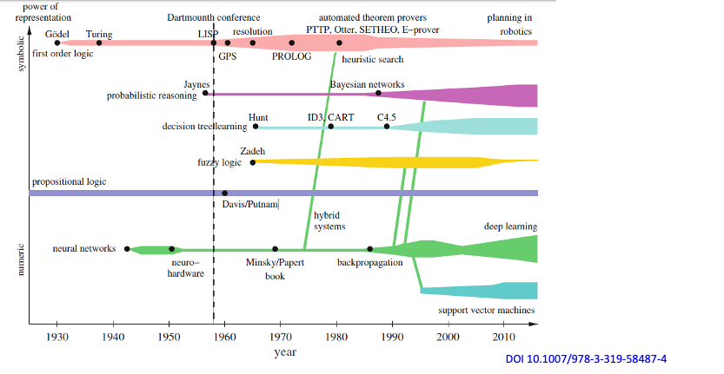
History of AI analytics

Slide 7
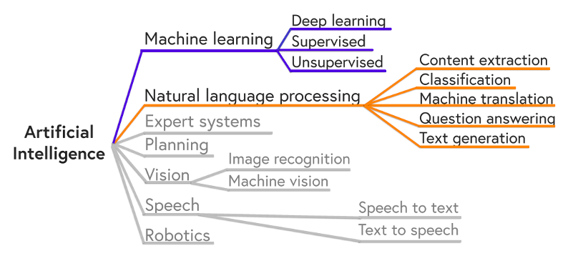
History of AI analytics

Slide 8
Unsupervised Machine Learning
No information about correct outputs are available.
No Regression No guesses about the function can be made
Classification? No information about the correct classes. But if we design our algorithm so that it exploits similarities between inputs so as to cluster inputs that are similar together, this might perform classification automatically
In essence: The aim of unsupervised learning is to find clusters of similar inputs in the data without being explicitly told that some datapoints belong to one class and the other in other classes. The algorithm has to discover this similarity by itself

Slide 9
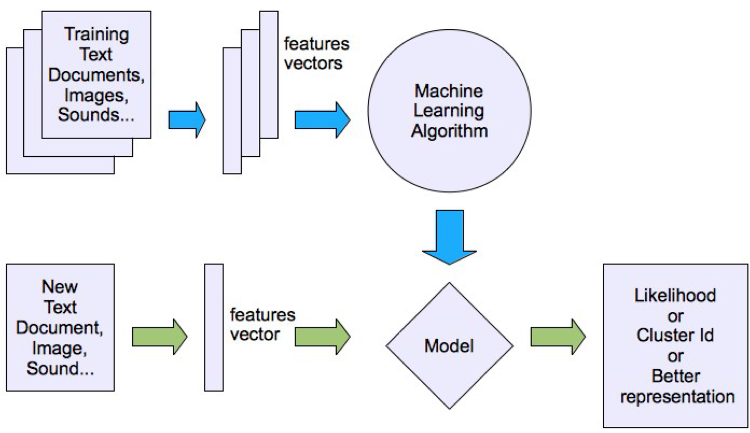
Unsupervised Machine Learning

Slide 10
Clustering algorithms
Clustering is a fundamental technique in data mining that involves grouping similar data points together.
It's a powerful tool for discovering hidden patterns, anomalies, and structures within large datasets.
Two popular clustering algorithms are K-means and Hierarchical Clustering.

Slide 11
K-means clustering
Groups data points into a specified number of clusters (K). K-means is primarily used for clustering and grouping similar data points. It does not predict labels for new data; it assigns them to existing clusters based on similarity.
How it works:
Initialization:
Randomly select K initial cluster centroids.
Assignment:
Assign each data point to the nearest cluster centroid based on a distance metric (e.g., Euclidean distance, Hamming distance).
Update:
Recalculates the centroid of each cluster as the mean of all points assigned to it.
Iteration:
Repeat steps 2 and 3 until convergence, i.e., when the cluster assignments no longer change significantly.

Slide 12
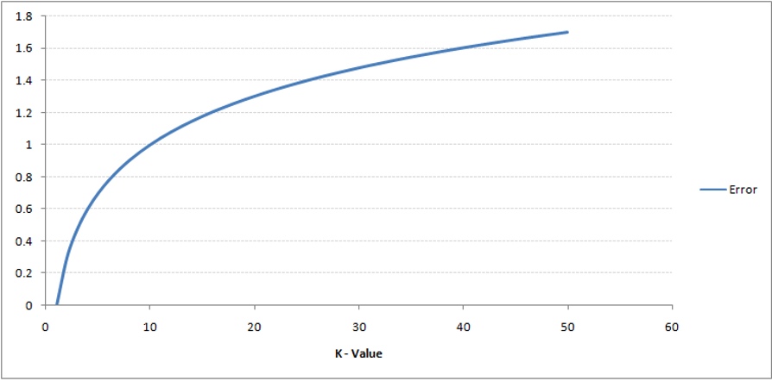
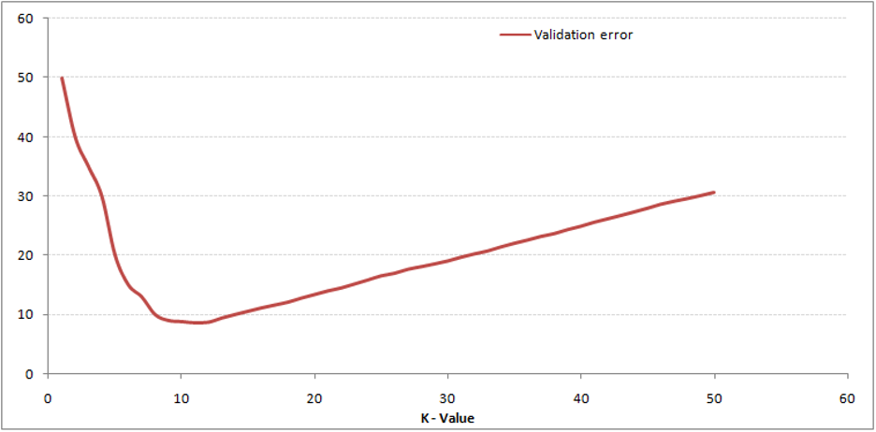
Determining the number of clusters (k)
Determining the k to select using training error and validation error for different values of k.
Validation error curve reaches a minima at a value of k = 9 (Elbow curve)

Slide 13
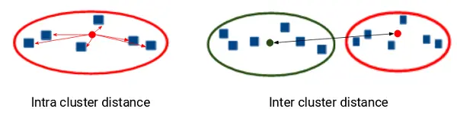
Model evaluation metrics
Inertia: Tells how far apart the points within a cluster are (intra-cluster distance). Helps in determining the number of K
Hence the smaller the inertia, the better the clustering model
Dunn index: Focuses on the inter-cluster distance (distance between two clusters). A good model should have a big Dunn index.
Silhouette score: measures the similarity of each point to its own cluster compared to other clusters and helps in determining number of K. (High score indicates a strong model, a score close to zero, indicates overlapping clusters

Slide 14
Hierarchical clustering
Hierarchical clustering creates a hierarchy of clusters, either by merging smaller clusters into larger ones (agglomerative) or by splitting larger clusters into smaller ones (divisive).
Types of Hierarchical Clustering:
Agglomerative Hierarchical Clustering:
Starts with each data point as a single cluster.
At each step, merges the two closest clusters based on a distance metric (e.g., single-link, complete-link, average-link).
Continues merging until all points belong to a single cluster.

Slide 15
Hierarchical clustering
Divisive Hierarchical Clustering:
Starts with all data points in a single cluster.
At each step, splits the cluster with the highest dissimilarity into two clusters.
Continues splitting until each cluster contains a single data point.

Slide 16
Hierarchical clustering example
Using Mall_Customers Dataset:
Segment the customers based on the spending_score (how much they spend in a store).
Use the other variables as the predictor features e.g. Annual Income.
Since the target variable is numeric, we use an euclidean distance measure to generate clusters and a dendogram

Slide 17
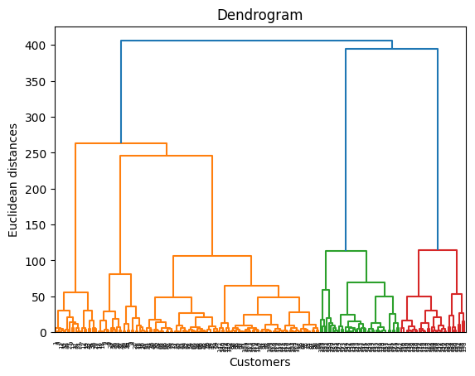
Hierarchical clustering example
Hierarchical Clustering:
Let’s count the vertical lines on the diagram and figure out how many clusters are best.
There are 5 clusters (see vertical lines of each cluster)
5
4
1
2
3

